Slide 1
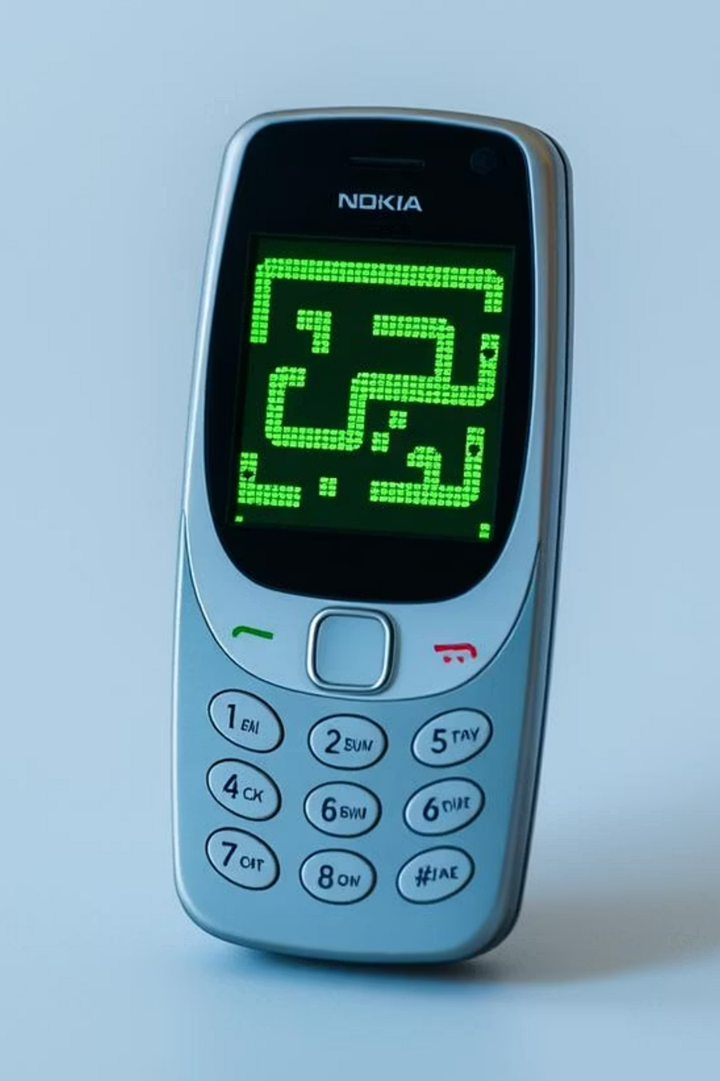
Snake Xenzia Game — Project Presentation
Vault of Codes Web Development Training Program
by Aditya Raj

Slide 2

Introduction to Snake Xenzia
This project is a modern, web-based recreation of the iconic Snake Xenzia game. It was developed as the culminating project for the Vault of Codes Web Development Training Program, showcasing foundational skills in web development.
Classic Reinvented
Built with Core Web Tech
A faithful, yet modern, adaptation of the beloved mobile game.
Exclusively uses HTML, CSS, and JavaScript, ensuring a dependency-free experience.
Browser-Native
Runs seamlessly within any web browser, requiring no external installations.

Slide 3
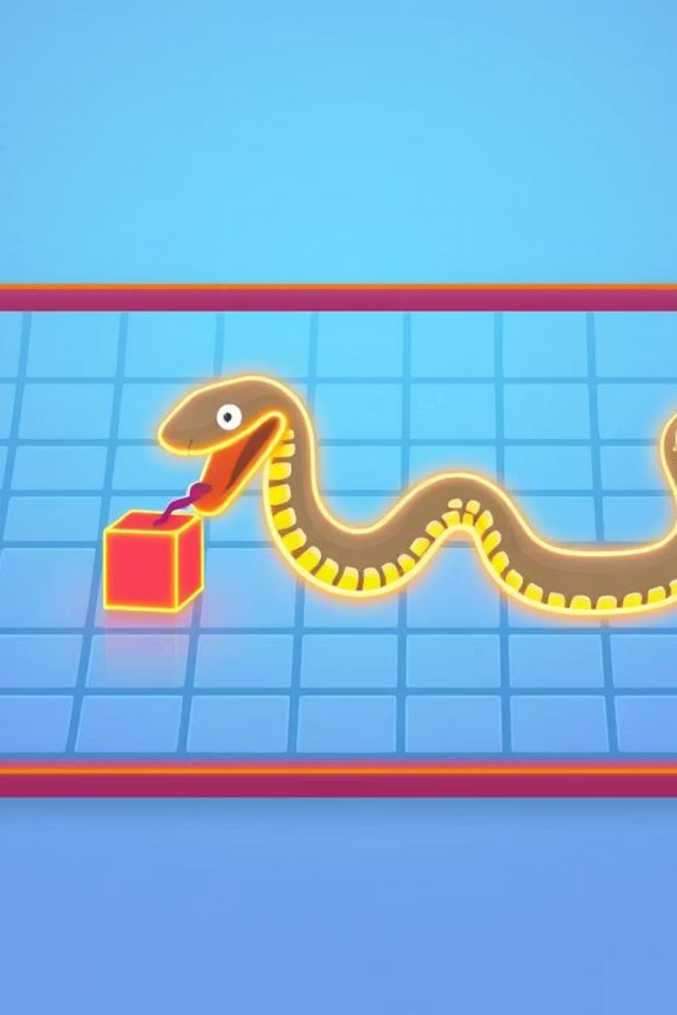
How the Game Works
The Snake Xenzia game operates on a simple yet engaging logic, providing intuitive gameplay for users.
Grid & Controls
The game features a grid where players control the snake using arrow keys (desktop) or swipes (mobile).
Eat & Grow
Players aim to consume food blocks, which causes the snake to lengthen and increases the score.
Game Over Conditions
The game concludes if the snake collides with the grid's boundaries or its own body.
Instant Replay
A "Restart Game" button allows players to immediately begin a new session.

Slide 4




Applications of the Project
This Snake Xenzia game serves multiple purposes, from demonstrating fundamental web development principles to providing a fun, accessible browser experience.
Skill Demonstration
Browser Entertainment
Showcases expertise in DOM manipulation, event handling, and canvas graphics.
Offers a delightful and engaging game suitable for users of all ages directly in their browser.
Educational Resource
Acts as a practical learning tool for aspiring web developers exploring game logic.

Slide 5
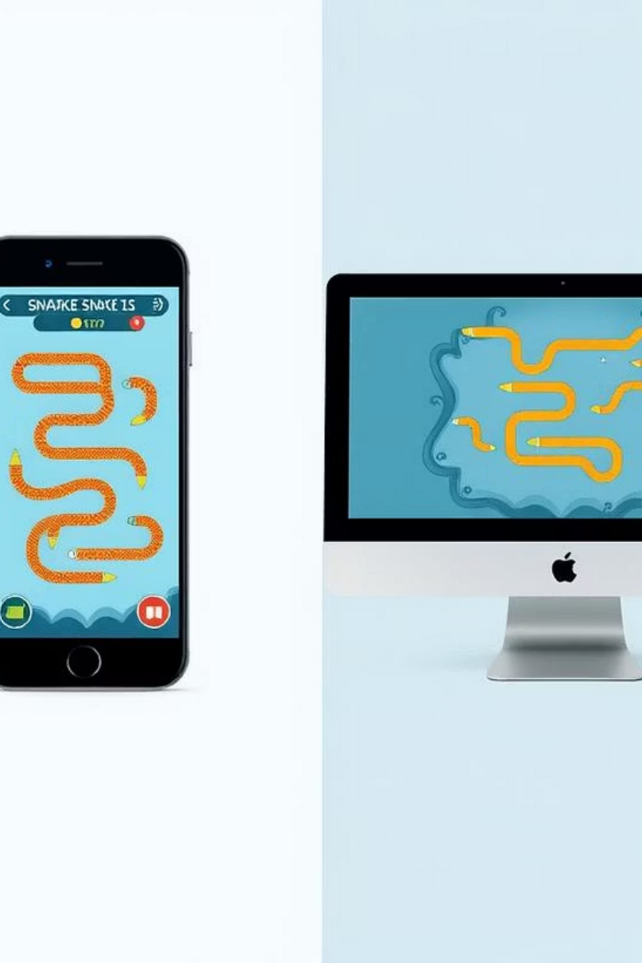
Strengths and Limitations
Advantages
Disadvantages
Fully responsive, optimizing for both desktop and mobile devices.
Restricted to single-player gameplay without multiplayer options.
Zero installation or backend dependencies; runs purely via an HTML file.
Lacks persistent features like high score tracking or user authentication.
Features a clean, contemporary user interface with precise controls.
The game's complexity is basic compared to modern gaming standards.

Slide 6
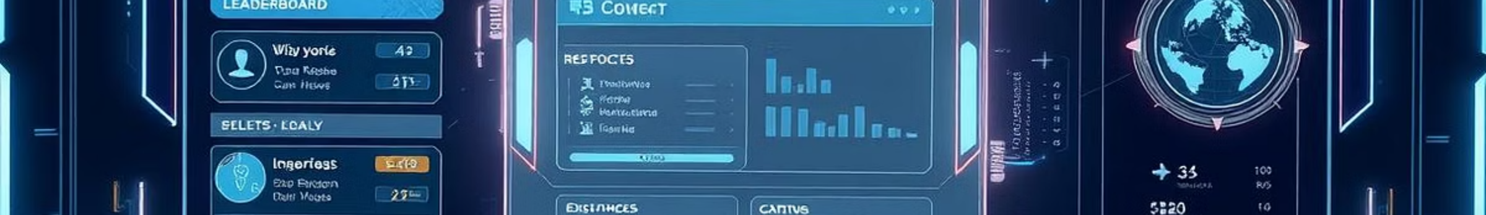




Future Enhancements
The Snake Xenzia game project has significant potential for future expansion, incorporating new features and improving the overall user experience.
Score Tracking
New Challenges
Implement persistent high scores and leaderboards to foster competition.
Introduce diverse levels, dynamic obstacles, and power-ups for varied gameplay.
Visual Overhaul
Online Deployment
Enhance graphics and animations for a more immersive and visually rich experience.
Deploy the game online to enable global access and sharing among players worldwide.

Slide 7
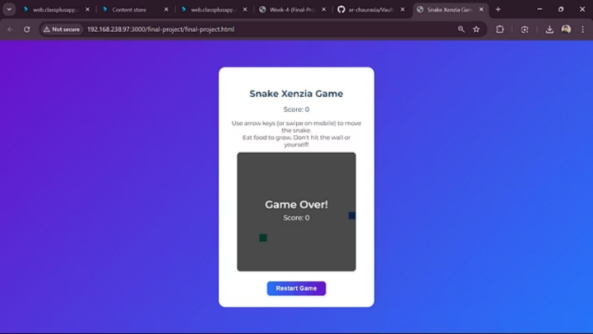
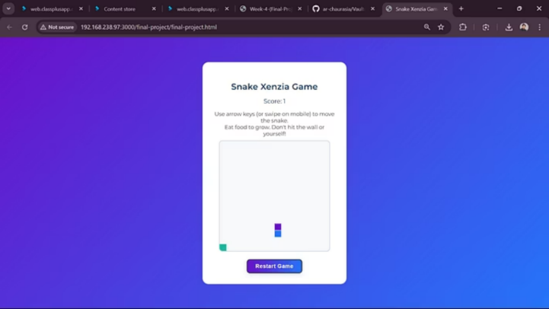

Game In Action
Here are some screenshots demonstrating the game at various stages of play.

Slide 8


